Slide 1



ABE Narrative Writers’ Workshop:
Getting Started
Introduce yourselves to those at your table and discuss:
What questions do you have about the narrative?
What are the strengths of your ABE consortium? Why?
What part(s) of the narrative do you think might be the most challenging? Why?

Slide 2

ABE Narrative Writers’ Workshop
Introduce yourselves to those at your table and discuss:
What questions do you have about the narrative?
What are the strengths of your ABE consortium? Why?
What part(s) of the narrative do you think might be the most challenging? Why?

Slide 3

ABE Narrative
Writers’
Workshop
Organized by Minnesota Department of Education
Sponsored by Literacy Action Network

Slide 4


Today’s Presenters Include
State ABE Staff
Todd Wagner
Brad Hasskamp
Astrid Liden
ABE Supplemental Service Providers
Literacy Action Network
Minnesota Literacy Council
Local ABE Staff
Glacial Lakes ABE
Hastings ABE
Metro South ABE

Slide 5
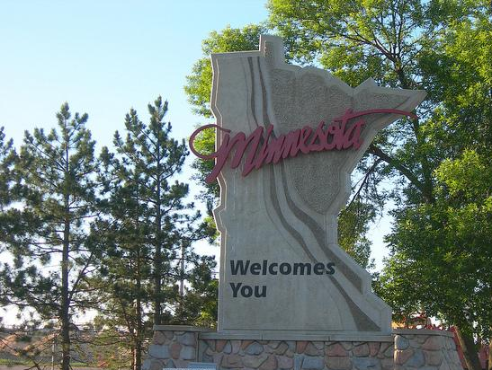
Welcome

Slide 6



Consortium Introductions
Consortium Name
Participant Names
What our consortium hopes to get from the narrative process
One word to describe our current consortium perspective

Slide 7

What is the Narrative?

Slide 8

Why the Narrative?

Slide 9
Sharing
What initial questions do you have about the narrative?
What are your consortium’s strengths that you hope get reflected in the narrative?
What part(s) do you think might be the most challenging? Why?

Slide 10






Introducing the
ACTION PLAN

Slide 11


Narrative Overview
Suggested Layout and Format
Document Letters
Narrative Question Numbering
New Developments
Notes:
10:20

Slide 12
Local Perspective:
Metro South ABE

Slide 13

Section 1:
Program Overview
Brad Hasskamp

Slide 14
Tips on Section
1
Introduce us to your consortium
Balance depth and concise writing
  Bullets and graphs work great for some content
  Reviewers like maps showing your service area
Reviewers typically wanted additional information about students (culture, age, languages, levels, goals, average hours per year, and other helpful factors/characteristics)

Slide 15

Section 2:
Program & Student Accountability
Brad Hasskamp

Slide 16

Tips on Section
2
Biggest and most complex section
  Detail is essential here
  Explain what and how to someone that does not work there or understand your consortium
Use the narrative process to improve: how could you do things better (i.e. PEP, Volunteers, Accountability)
Assessment policy
  How does your consortium implement the state assessment policy?
  How is your responding to the 40-hour post-testing rule?

Slide 17
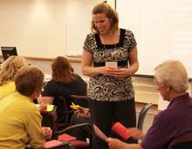
Section 3:
Staff & Professional
Development
Astrid Liden
Kellie McGowan, Metro South ABE
Gina Carpenter, Metro South ABE
Notes:
11:30

Slide 18
Session Objectives:
Reflect on your current process for PD planning
Follow a data-driven process for PD planning
Use PD survey data to inform consortium and individual PD planning
Use templates provided to develop PD plans
Identify features of effective PD and choose PD opportunities based on identified needs
Notes:
ASTRID - 2 minutes
Introduction:
• presenters introduce themselves and walk through session objectives
• clarify that focus is primarily on consortium PD planning
•note that we’re covering A LOT of material; we’ll be able to introduce you to a process and tools, but not go into depth for any of the steps; can contact Astrid for information or guidance

Slide 19
What is your current approach?
What is your current approach to professional development (PD) planning for your consortium?
How is this working for you? What do you see as the benefits and drawbacks of your current process?
Notes:
ASTRID – 3 minutes (Large Group Brainstorm)
Refection & large group brainstorm on current approach to PD planning
* What are your burning questions as you approach the task of developing your consortium plan? Write them down as you think of them. If they are not addressed in this session, follow up with us.

Slide 20
Cafeteria approach
“We always go to that conference.”
“That sounds like a fun workshop.”
“My friend is going to that session, so I’m going to tag along.”
“The only trainings we participate in are regionals because that’s all we can afford.”
Notes:
ASTRID – 1 min.
Many have typically approached PD without a plan.
* With the cafeteria approach, they pick and choose randomly based on what looks good in line, without a clearly thought-through plan made in advance.

Slide 21
What is data-driven PD planning?
PD needs are identified and prioritized based on data
SMART objectives are developed based on those needs
PD activities align with identified needs & objectives
Notes:
ASTRID - 2 minutes ( 2 slides)

Slide 22
Why is it important?
  Improved understanding of staff and learners’ needs and characteristics
  Alignment of perceived needs with expected outcomes
  Selection of effective activities & materials to support training goals
  Effective use of limited resources
  Impact of professional development is maximized
Notes:
ASTRID - continued

Slide 23
PD Planning Process
STEP 1:
Assemble a PD Planning Team
STEP 2:
Collect & analyze data
STEP 3:
Identify & prioritize needs
STEP 4:
Develop objectives
STEP 5:
Identify activities to meet objectives
STEP 6:
Carry out objectives
STEP 7:
Reflect & maximize impact of activities
STEP 8:
Evaluate whether objectives have been met
Notes:
ASTRID -2 min.
Briefly introduce the steps to PD Planning
PD planning process handout

Slide 24
Suggested PD Planning Timeline
Winter
PD Survey
Spring
Consortium PD Plan
Spring-Fall
Individual PD Plan

Slide 25
STEP 1:
CONSIDER:
Who is/will be part of your PD planning team?
When do/will you meet? What is/will be your planning cycle?
What resources do/will you need?
SUGGESTIONS:
Include a mix of roles and perspectives
Leadership support and involvement
Assemble a PD planning team
Notes:
3 minutes
METRO SOUTH approach

Slide 26
STEP 2:
CONSIDER:
What data do you currently use to inform PD planning?
What data could you use in the future?
Collect & analyze data to identify PD needs
Notes:
ASTRID– 5 minutes
* Large group discussion: What data do you currently use? What other data could you use? (List on flip chart)
Hand out consortium PD plan template. Participants review list of data, add anything from flip chart that’s not on list
Hand out individual PD plan template

Slide 27
STEP 3:
CONSIDER:
Which needs are supported by the greatest amount and diversity of data?
Which needs reflect local and state priorities & initiatives that need to take precedence?
Which needs are possible to address in the upcoming program year?
Which needs can be met with available personnel, resources, and technology capabilities?
Identify & prioritize PD needs using a variety of data
Notes:
ASTRID – 2 minutes
* presentation & discussion of key guiding questions to be used in prioritizing needs

Slide 28
PD Survey
Statewide PD survey administered in January-February
PD survey questions available at: http://atlasabe.org/pd-system/research-and-surveys
Consortium-level reports available from ATLAS upon request
Notes:
10 min?
ASTRID
-review sections of PD survey
-hand out copy of survey questions
METRO SOUTH
-share what data was used to inform consortium PD plan & how it was used
-share how the survey data was used to inform consortium PD plan
-share examples of survey data and the needs that were identified from that data

Slide 29
STEP 4:
SMART objectives are:
Specific – What? Why? How?
Measurable – How will I measure progress & know I’ve achieved my goal?
Action-oriented – Can I take actions to accomplish this objective?
Realistic – Is it challenging but still possible to achieve?
Time-bound – What is my timeframe for this goal?
Develop measurable PD objectives
“_____ will be able to ____ by ____.”
Notes:
ASTRID - 5-10 minutes
-explanation SMART objectives
-emphasize that PD objectives are related to increased knowledge and skills
-introduce small group activity on following slides

Slide 30
Group Activity: Rate the objective!
Read the objective in the box, taken from an actual consortium PD plan, and give it a rating of 0 – 5, based on the scale below:
Example 1:
“XYZ ABE staff will be aware of ABE changes and rationale behind the changes.”
Specific – 1 pt.
Measurable – 1 pt.
Action-oriented - 1pt.
Realistic – 1 pt.
Time-bound – 1 pt.
What is your rating?
How would you improve this objective?

Slide 31
Group Activity: Rate the objective!
Read the objective in the box, taken from an actual consortium PD plan, and give it a rating of 0 – 5, based on the scale below:
Example 2:
“Improve reading instruction.”
Specific – 1 pt.
Measurable – 1 pt.
Action-oriented - 1pt.
Realistic – 1 pt.
Time-bound – 1 pt.
What is your rating?
How would you improve this objective?
Notes:
Group Activity - continued

Slide 32
Group Activity: Rate the objective!
Read the objective in the box, taken from an actual consortium PD plan, and give it a rating of 0 – 5, based on the scale below:
Example 3:
“Each member of the staff will establish a Google account and learn to use a variety of tools offered through this service, including file sharing with Google docs. Staff will use Google Docs to upload, access, review and edit sections of the 5 year Grant Narrative over the course of the year."
Specific – 1 pt.
Measurable – 1 pt.
Action-oriented - 1pt.
Realistic – 1 pt.
Time-bound – 1 pt.
What is your rating?
How would you improve this objective?
Notes:
Group Activity - continued

Slide 33
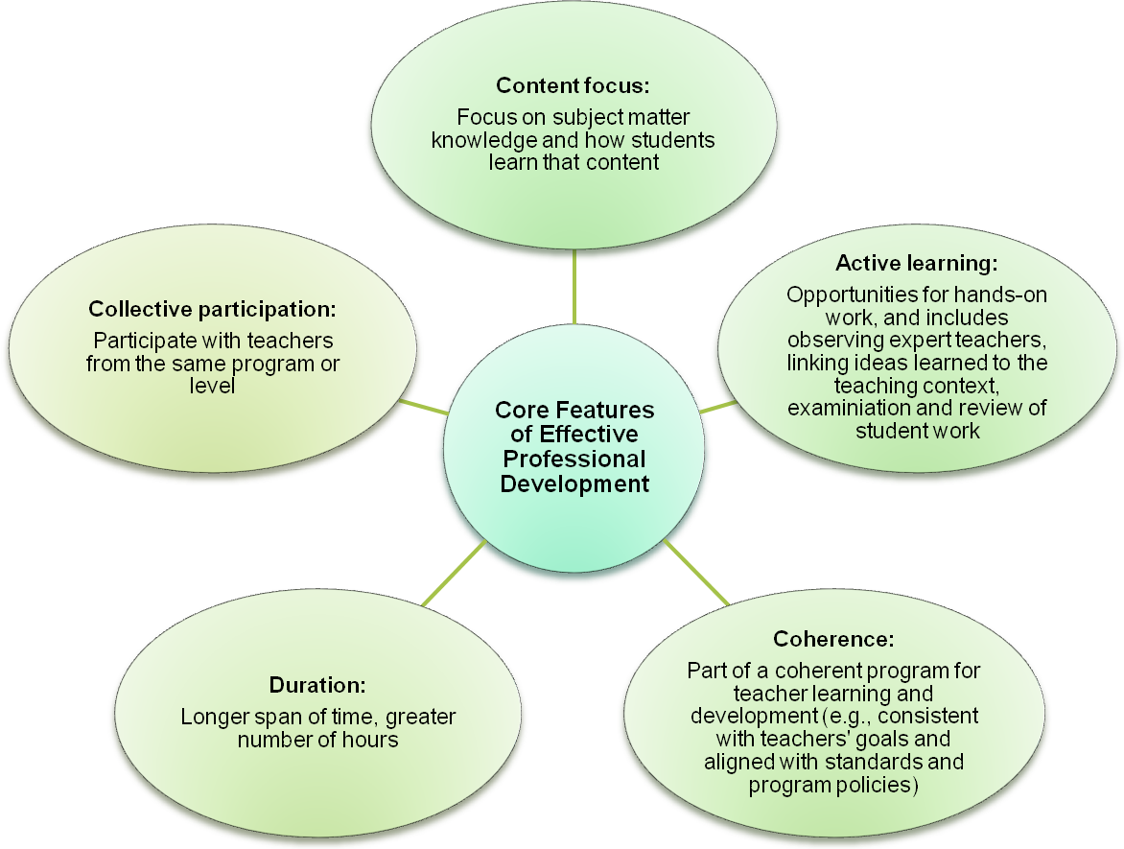
Features of effective PD
Notes:
33
ASTRID – 3 minutes
-outline the features of effective PD

Slide 34
STEP 5:
Traditional PD Conferences and Workshops
    Choose sessions based on your identified needs
    Focus your efforts - participate in a strand of sessions
    Share information with peers
Online courses
Study circles
Professional learning communities (PLCs)
Site visits
Peer observation/mentoring
Program & product development
Identify & develop PD activities to meet the objectives
Notes:
ASTRID – 5 minutes
-distribute and discuss handouts: ABE Supplemental Services, Job-Embedded PD Resources, ABE PD Resources, ABE Events
METRO SOUTH: any input on how activities are/were chosen
.

Slide 35
STEP 6:
Small Group Activity
Choose ONE of the sample objectives you refined (made SMART- “er”) earlier and discuss with your partner/s:
What PD activities would help achieve the objective you refined?
What resources (presenters, materials, etc.) would you need to carry out this activity?
Carry out / participate in PD activities
Notes:
ASTRID – 5 minutes
-participants work with a partners at table/small groups to identify PD activities that might best address one of the three PD objectives that were developed in the previous activity

Slide 36
STEP 7:
Reflective practice license renewal requirement
Activity log
Teacher journal
Staff meetings
Professional learning communities
Meeting with supervisor or colleague
???
Reflect on & maximize impact of PD activities
Notes:
ASTRID – 2 to 3 minutes
-present & discuss options for encouraging reflection and sharing of PD
-participants identify several options they want to try in their programs

Slide 37
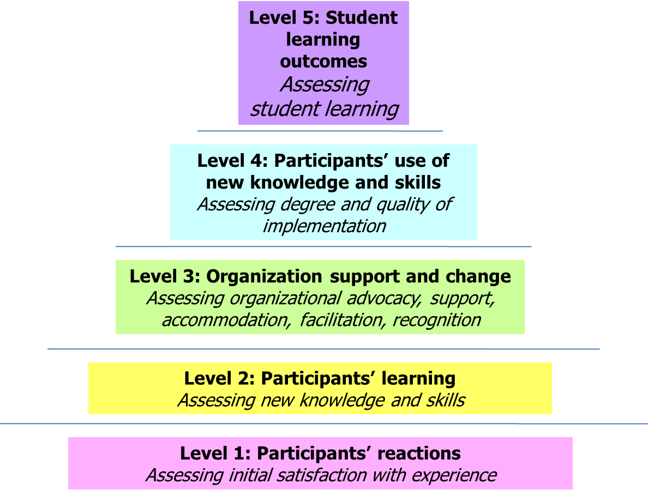
STEP 8:
Evaluate whether objectives have been met
Evaluating PD
(adapted from Guskey, 2002)
Notes:
ASTRID – 2 minutes

Slide 38
Questions?
Astrid Liden: Astrid.Liden@state.mn.us
phone: 651-582-8424
Updated PD templates are available at www.mnabe.org
Notes:
METRO SOUTH- final comments/words of advice

Slide 39

Section 7:
Technology & Distance Learning
Susan Wetenkamp-Brandt, Minnesota Literacy Council
Notes:
1:10

Slide 40
Tips on Section
7
Use the template provided
Add as much detail as possible
  What exists now and how do you incorporate tech?
  What are your future goals and when do you hope to accomplish them
  For future timelines, prioritize a potential timeline that you hope to follow
Local consortia are expected to create a vision and implement the following:
  Technology resources available on site
  Incorporation of technology into instruction
  Use of distance learning
  Use of Northstar Digital Literacy Standards

Slide 41


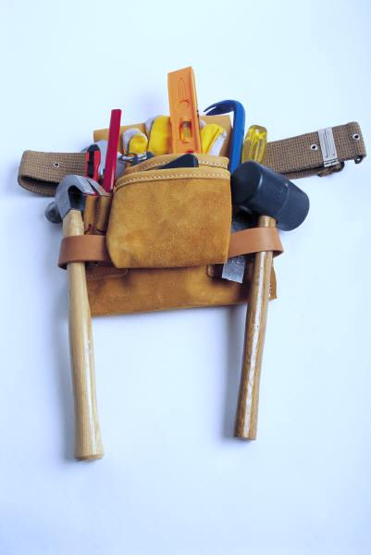

Tools for Collaboration
Susan Wetenkamp-Brandt

Slide 42
Tools for Collaboration
Google Doc’s/Drive (http://drive.google.com)
Drop Box (www.dropbox.com)
PB Works (http://pbworks.com)
Wiggio (http://wiggio.com)

Slide 43
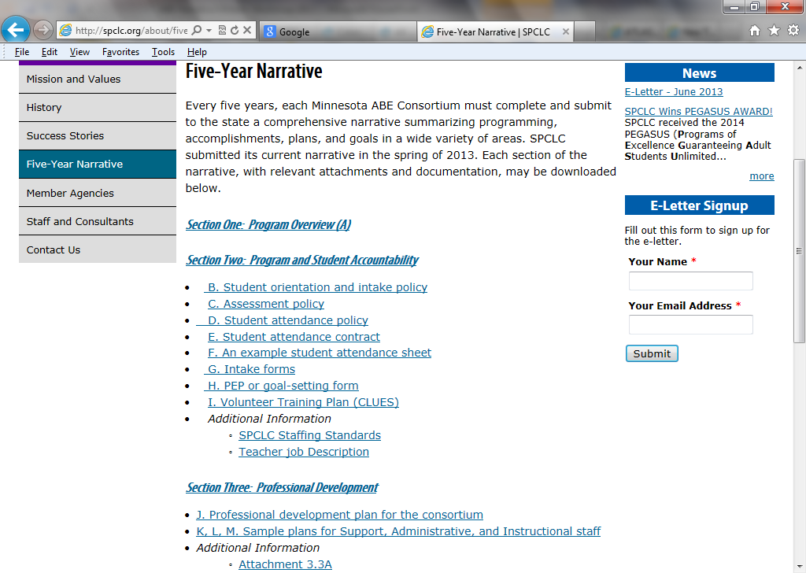

Decision: Online or Binder?

Slide 44
Local Perspective:
Glacial Lakes ABE

Slide 45

Lunch Chats with Local Programs
Notes:
Lunch: 12:00-12:45

Slide 46

Section 4:
Instructional Program Description
Brad Hasskamp
Notes:
11:00

Slide 47
Tips on Section
4
Use the templates provided
  Check out Mankato’s online narrative
Have instructors help develop this section
  Start this section early and allow time for writing and editing
Articulate all programming happening in the consortium
  Types of programming can be grouped if they do (or will) teach the same content

Slide 48

Section 5:
Program Governance
& Coordination
Brad Hasskamp
Notes:
12:40

Slide 49
Tips on Section
5
Include your consortium MOU
  Check out St. Paul’s online narrative
  Consortium meetings are required
Clearly articulate how big programming decisions are made and implemented in your consortium
  Do you have an articulated process?
  How could new members join your consortium?
How do you market your program?
  Do your stakeholders know what you do?

Slide 50
Local Perspective:
Hastings ABE

Slide 51

Section 6:
Program Collaboration
& Partnerships
Brad Hasskamp

Slide 52
Tips on Section
6
Articulate your partnerships
  Don’t forget to describe who they are and what you do together
Have an updated MOU with the workforce center that accurately describes your work together
Describe your role in developing the regional transitions plan, even if you do not directly receive any funds

Slide 53

Section 8:
Future Plans
Brad Hasskamp

Slide 54
Tips on Section
8
Create a future plan that embeds lessons learned and priorities from the rest of the narrative.
  NRS Level Gains
  Transitions/Adult Career Pathway Programming/Partnerships
  Implementing content standards
Identify and comprehensively articulate top objectives and multiple strategies for a five-year plan
Own this plan and share with staff

Slide 55
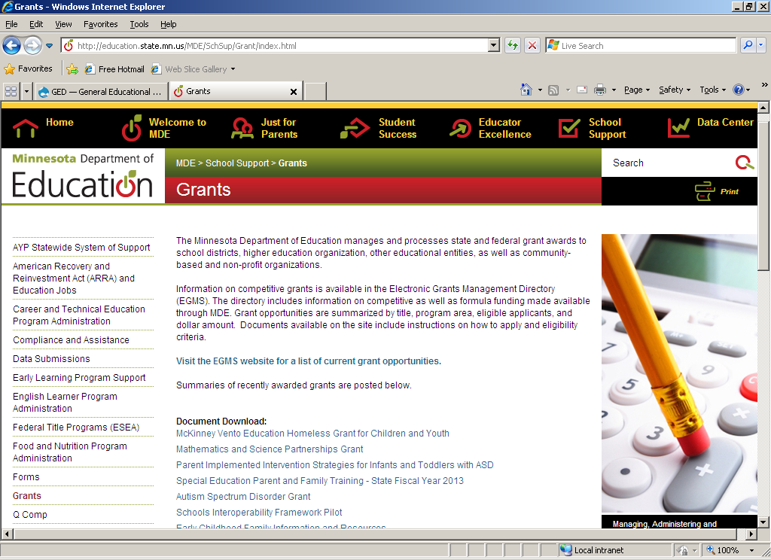
Section 9:
Annual Consortium Application
Brad Hasskamp
Notes:
2:55

Slide 56
Tips on Section
9
Attach all documents
  If one type of document does not apply to your consortium, please note it in your narrative
    Certain consortium tables
    Sub-grantee tables
Grant assurances are included as part of your local program manual
Reviewers will be evaluating your tables

Slide 57

Section 10:
New Consortia Authorization
Brad Hasskamp

Slide 58
Tips on Section
10
Only applicable for new or restructured consortia
Identify the consortium status
  First-time
  Restructured
  Low Performance
If information is articulated earlier, please cite where we can find it

Slide 59

Notes:
2:10-2:25

Slide 60
Developing your
ACTION PLAN

Slide 61

Developing A Plan
Start working out your consortium’s plan
Identify sections that are priorities
Identify any sections you need resources or further assistance/training
What is your next step?
Notes:
2:25

Slide 62
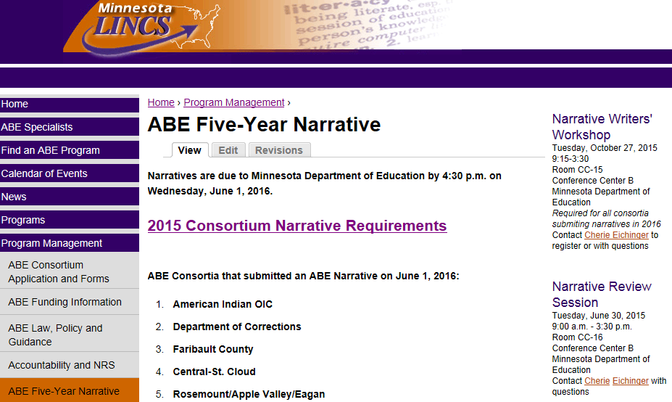
Check out the Narrative website

Slide 63
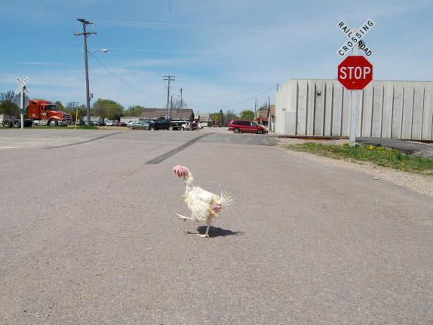
Questions?

Slide 64






Has your perspective changed?

Slide 65
For More Information…
ABE Narrative Web Site: www.mnabe.org
In “Program Management”
Find “ABE Five-Year Narrative” page
Brad Hasskamp, ABE Policy & Operations
(651) 582-8594
brad.hasskamp@state.mn.us

Slide 66

Thank You! Good Luck!
Notes:
Evaluations, CEU’s and additional questions

