Slide 1
COMPREHENSIVE CAREER PATHWAYS
MINNESOTA ADULT BASIC EDUCATION

Slide 2
noun
ca•reer path•way
a series of connected education and training programs and support services that enables people to secure or advance in employment within a specific industry or occupational sector.

Slide 3
WORK
BIRTH
K-12
WORK
RETIREMENT
EDUCATION TRAINING

Slide 4
WORK
BIRTH
K-12
WORK
RETIREMENT
EDUCATION TRAINING

Slide 5
THE TIPPING POINT*
ONE YEAR OF POSTSECONDARY CREDIT AND A CREDENTIAL
THE TIPPING POINT
COLLEGE READY
HIGH SCHOOL DIPLOMA
*Washington State Board for Community and Technical Colleges. “Building Pathways to Success for Low-Skill Adult Students: Lessons for Community College Policy and Practice from a Longitudinal Student Tracking Study (The “Tipping Point” Research).”
8TH GRADE
PRE-LITERATE

Slide 6
NEW PARTNERSHIPS
CAREER PATHWAYS
NEW PROGRAM MODELS

Slide 7
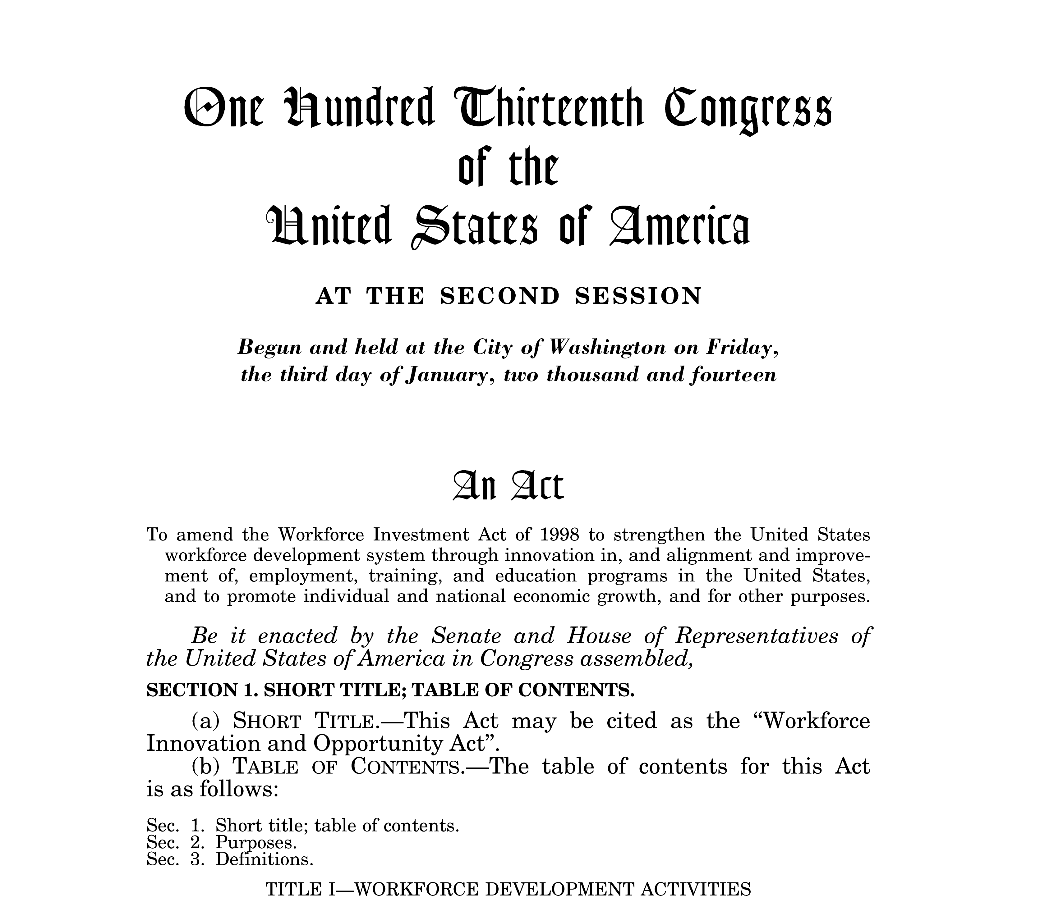

Slide 8
PATHWAY PARTNERSHIP
PATHWAY SECTOR
PATHWAY DESIGN
PATHWAY INSTRUCTIONAL DELIVERY
PATHWAY PARTICIPANT SUPPORTS
PATHWAY MEASUREMENT

Slide 9
SHORT
JOB-FOCUSED
QUICKER TIME-TO-EMPLOYMENT
ACCESSIBLE
EMPLOYER INVOLVEMENT
LONGER
TERM
CAREER-ORIENTED
GREATER ECONOMIC PAYOFF

Slide 10
ASSOCIATES DEGREE AND BEYOND
EMPLOYER INVOLVEMENT
INTEGRATED INSTRUCTION
POSTSECONDARY CREDENTIAL
SUPPORT SERVICES AND NAVIGATION
BRIDGE INSTRUCTION
ADULT BASIC EDUCATION
WORK SKILLS
UNSKILLED JOB
OR
UNEMPLOYMENT
SEMI-SKILLED JOB
ENTRY-LEVEL SKILLED JOB
ENTRY-LEVEL SPECIALIZED SKILLED JOB

Slide 11
THE TIPPING POINT

Slide 12
THE TIPPING POINT

Slide 13
COMPREHENSIVE CAREER PATHWAYS
MINNESOTA ADULT BASIC EDUCATION

