Slide 1
Creating a Third Pathway Minnesota’s State Adult Diploma
August 2014
Brad Hasskamp, MDE ABE
Karen Wolters, Mankato ABE

Slide 2
Standard High School Diploma for Adults
Background
Legislation
Implementation
Questions
Discussion

Slide 3
Background: 2012-14 Task Forces

Slide 4
Two Traditional Paths
K-12 Diploma
Credit-based
Time intensive
Diploma issued by local school district
Control by local school district
GED®
Based on series of standardized high-stakes assessments
Can be completed quickly
Diploma by Minnesota Department of Education
Control by private organization

Slide 5
Initial Literacy Action Network Adult Diploma Task Force
Created 2012 by LAN at request of MDE as part of their Supplemental Services grant
Purpose: Explore potential for creating a statewide adult diploma as an alternative to the GED
Impetus: The need to provide meaningful adult secondary credential in a consistent manner statewide

Slide 6
Membership representative of Minnesota’s ABE programs
Co-Chairs
Tim O'Brien
Kristine Wehrkamp
Members
Beverlee Mountain
Sarah Larson
Marty Olsen
Julie Nigon
Legislative Liaison: Tom Cytron-Hysom
MDE Representative: Brad Hasskamp

Slide 7
Worked with SheridanStowe
Produced June 2012 report
Researched needs and trends regarding core standards/secondary credentials in Minnesota and nationwide
Documented possible options
Explored how an Adult Diploma might work in Minnesota
Report adopted by LAN Board

Slide 8
Stakeholder Focus Groups
3 separate focus groups
2 community sessions
St. Paul
Rochester
1 student focus group
St. Paul

Slide 9
Major Focus Group Findings
Concern that the diploma be consistent and portable statewide
Should assess 21st century skills needed by employers
Will the new Adult Diploma provide real, relevant and rigorous evaluation of student achievement?
Will the new Adult Diploma address the issue of credit for prior learning?

Slide 10
More Questions Raised
How will the initiative establish academic alignment with integrated, contextualized, competency based training?
How can the initiative reduce the cost of remediation at the postsecondary level?

Slide 11
Questions from Student Focus Groups
Will this option recognize educational attainment achieved in another country?
Will skills attained through work experience (both domestic and foreign) be factored into this new option?
Can support services be provided to structure opportunities for increased English language skills?
What career pathways are available for adults with limited English proficiency? Can this option help students transition quickly into the workforce?

Slide 12
2013-14 Standard Adult High School Diploma Task Force
April 2014

Slide 13
Standard Adult Diploma Task Force
Members
5 ABE practitioners,
1 Chamber of Commerce representative,
1 DEED representative,
1 MnSCU representative, &
1 MDE representative
Sessions
6 Meetings (August-January)
Report
Submitted recommendations February

Slide 14
Members
Karen Wolters, Chair (Mankato)
Kristine Kelly (Robbinsdale)
Kate Ronald (Volunteers of America)
Tamra Sieve (Metro South)
Ali Farah
Jim Colwell (MDE)
Karen Hynick (MnSCU)
Judy Mortrude (DEED)
Amy Walstein (Chamber of Commerce)

Slide 15
Third Option for High School Completion
Adult Secondary Credential Options
K-12 Diploma
G.E.D.
Adult Diploma
Currently 2 options exist:
GED
K-12 Diploma Credit Completion
What would a third option look like?
State-Issued Standard Adult High School Diploma
Competency Based
For those not eligible for K-12 (ages 21+)

Slide 16
Recommendation
Go Back to the Capitol
Statute change rather than Rulemaking

Slide 17
Legislation

Slide 18
Major 2013 & 2014 Legislative Focus for LAN Establishment of Adult Diploma
Bipartisan support and authorship
Met with many legislators
Testified in education committees
Strong support in House and Senate
Passed without opposition

Slide 19
Reasons for legislative support
Need to provide meaningful statewide adult secondary credential to benefit individuals, colleges & business by preparing people for the workforce & higher education
Need to provide statewide access
Need to standardize adult diploma
Need for alternative to GED

Slide 20
Breaking down the statute

Slide 21
Minnesota Statute 124D.52 (subd. 8, a)
The commissioner shall provide for a standard adult high school diploma to persons who:
Are not eligible for K-12 services;
Do not have a high school diploma; and
Successfully complete an ABE program of instruction approved by the commissioner of education necessary to earn an adult high school diploma

Slide 22
Minnesota Statute 124D.52 (subd. 8, b)
Persons participating in approved ABE adult diploma programs must:
Demonstrate the competencies, knowledge, and skills
Be equally well prepared and qualified by employers and postsecondary

Slide 23
Applications
MDE will establish requirements/process for application approval
ABE consortia will apply to MDE for approval to offer this programming
ABE consortia will renew applications/approval through 5-year narrative process

Slide 24
Individual Advising
Identify learning goals
Assess individual skills/experience
Identify career pathway
Identify instructional needs
Create individual learning plan
Portfolio/Plan
Document and a process

Slide 25
Standard Requirements
Align with K-12 academic standards pertinent to adult learners in:
Language Arts, includes reading, writing, listening, speaking
Mathematics
Social Studies
Science
Employability & Career Awareness, includes digital literacy

Slide 27
Demonstrating Competency
Options
Prior experience, including K-12 & college courses, job experience & training
Test verified knowledge
ABE instruction and course completion
Applied and experiential learning, including contextualized projects

Slide 28
Example
ELEPHANTS
Larger than the moon?
Which of the following is the largest?
A. A Peanut
A. An Elephant
B. The Moon
D. A Kettle

Slide 29
Meeting Student Needs
Portability
(common standards)
Diploma from State (and district?)
Transferability (common transcript)

Slide 30
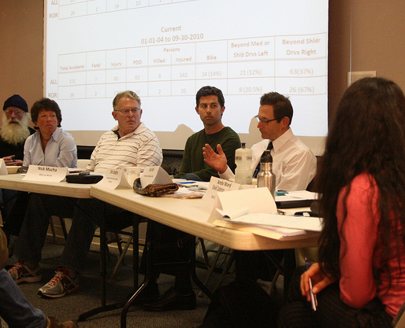
Support and Consultation
Consultation Team
Guidance, policy, review program applications, accountability measures
ABE Working Groups
Develop specific standards, advising process, applications, & other procedures
Department Assistance
MDE provides assistance in development, implementation and evaluation of programming

Slide 31
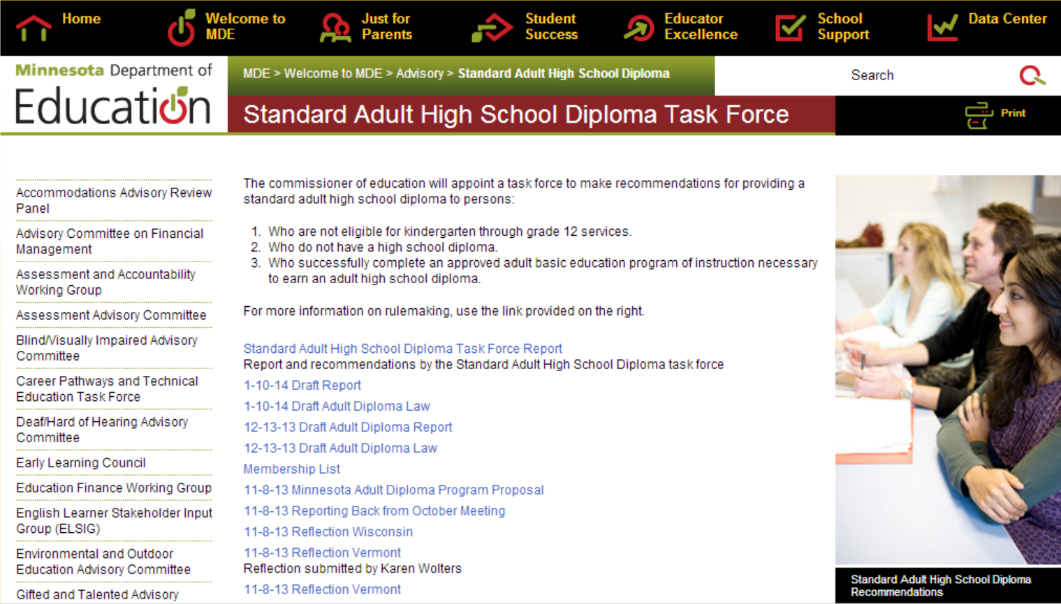
For more information on the Adult Diploma Task Force and the recommendations, please find additional resources on the MDE page. http://education.state.mn.us/MDE/Welcome/AdvBCT/StandultHighSchDiplTaskForce

Slide 32
Adult Diploma: Big Questions
Consultation?
Pilots?
Allowable activities?
Applications?
Counseling/advising?
Full launch date?
“Equally prepared?”

Slide 33
It’s been busy. It’s only getting busier.

Slide 34
Implementation 2014-16

Slide 35
Implementation Actors
Minnesota Department of Education
Working Group
Consultation Team
ABE Supplemental Services
Approved Adult Diploma Programs

Slide 36
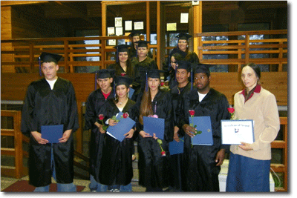
Recommended Implementation Phases
Planning
(Now-October 2014)
2. Pilot
(November 2014-June 2015)
3. Full Launch
(July 2015-ongoing)

Slide 37
New Standard Adult Diploma Process
Intake
Assess literacy skills
Instruction
English Language Arts
Evaluation
Post-test learners
Prior experience-based Competency verification
Identify student goals (career, learning, etc.)
Develop individualized learning plan
Math
Career Development and Employability Skills
Track progress towards diploma and goals
Provide additional support services as needed
Graduating Advising Session
Ensure completion of necessary competencies
Create transitions plan to students’ future goals
Provide additional support services as needed
Revise plan
Science
Social Studies

Slide 38
Implementation Components
Standards
Transcripts
Issuing Diplomas
Advising
Portfolio
Pilots

Slide 39
Questions

Slide 40
Discussion
Concept
Implementation
Comparing Paths
Other?

