Slide 1
Getting Started
Discuss at your table.
How long have you been in ABE?
What is your role?
Where do you work?
How do you work with ABE accountability and/or policy?
What questions do you have about ABE accountability and policy? (Jot your questions down individually on post-its. One question per post-it.)

Slide 2
Adult Basic Education Accountability 101
Heather Williams | Student Data and Assessment Specialist, Robbinsdale & SPARC Chair
Brad Hasskamp | Adult Secondary Credential and Education Policy Specialist, MDE
Todd Wagner| State ABE Director, MDE
Jenny Schlukebier| SiD, Urban Planet
2018

Slide 3
Today’s Topics
Warm Up and Questions
Welcome to WIOA
The 6 Accountability Measures
Digesting MSG (Measurable Skill Gain)
Interpreting the new Educational Functioning Level Descriptors
The how and when of the new TABE and CASAS tests
Getting everything into SiD
Sharing Success (Targets, Report Cards and Program Improvement)
Local Changes, Ideas and Questions
Notes:
Heather

Slide 4
Warm Up and Questions
Notes:
Heather

Slide 5

Collecting your questions
What questions do you have about ABE accountability and policy?
(Jot your questions down individually on post-its. One question per post-it.)
Please give your questions to the presenters.

Slide 6
Welcome to WIOA
Notes:
Brad

Slide 7

What is WIOA?
WIOA stands for the Workforce Innovation and Opportunity Act of 2014. It is a federal law that governs workforce development programs, including Adult Basic Education, the WorkForce Centers, and Vocational Rehabilitation.

Slide 8
WIOA’s 5 Titles
Law Title (Section) | Name | Program/Activities | Who oversees in Minnesota
Title I (Subtitle A) | Workforce Development Activities (System Alignment) | All WIOA Programs | DEED and MDE
Title I (Subtitle B) | Workforce Development Activities (Workforce Activities and Providers) | Adult, Youth, and Dislocated Worker Programs | DEED
Title II | Adult Education and Family Literacy Act (AEFLA) | Adult Basic Education | MDE
Title III | Wagner-Peysar Act | Workforce Centers (One-Stops) | DEED
Title IV | Rehabilitation Act | Vocational Rehabilitation (VR) | DEED
Title V | General Provisions | All WIOA Programs | DEED and MDE

Slide 9
Defining “Adult Education”
Academic instruction and education services below the postsecondary level that increase an individual’s ability to:
Read, write, and speak in English and perform mathematics or other activities necessary for the attainment of a secondary school diploma or its recognized equivalent;
Transition to postsecondary education and training; AND
Obtain employment.
Source: WIOA Section 203

Slide 10

ADAPT/SIMPLIFY: 3 Types of Federal ABE Grant Funding
WIOA Section 231 (Local AEFLA providers)
WIOA Section 225 (Local AEFLA providers serving students in corrections)
WIOA Section 243 (Local Integrated English Literacy and Civics, IEL/Civics, providers)
Competitive grant processes for WIOA Section 231 and 225 will be combined.
Grants for WIOA Section 243 (IEL/Civics) will be competed separately.

Slide 11

What are adult education and literacy programs, activities and services?
Federal Regulations Citation
(Code of Federal Regulations, or CFR, §463.30)

Slide 12
Adult Education and Literacy Programs, Activities and Services include:
Adult education,
Literacy,
Workplace adult education and literacy activities,
Family literacy activities,
English language acquisition activities,
Integrated English literacy and civics education,
Workforce preparation activities, or
Integrated education and training.

Slide 13
What is an English language acquisition program?
Federal Regulations Citation
(CFR §463.31)

Slide 14
English Language Acquisition Program
A program of instruction—
(a) That is designed to help eligible individuals who are English language learners achieve competence in reading, writing, speaking, and comprehension of the English language; and
(b) That leads to—
(i) Both: (1) Attainment of a secondary school diploma or its recognized equivalent; and (2) Transition to postsecondary education and training; or
(ii) Employment.

Slide 15

Acronym Fever!
ELL: English language learner (a type of eligible individual defined in WIOA)
ELA: English language acquisition (a defined adult education and literacy activity under WIOA)
ESL: English as a Second Language (a set of federal educational functioning levels used for ELLs)
ELP: English Language Proficiency (a set of supporting standards for instruction for ELLs)

Slide 16
How does an English language acquisition program prove it leads to attainment of a secondary school diploma, G.E.D., postsecondary education, training or employment?
Federal Regulations Citation
(CFR §463.32)

Slide 17
3 Options
Have implemented State adult education content standards in curriculum, lesson plans, or instructional materials; or
Offer educational and career advising that help students transition to postsecondary education or employment; or
Be part of a career pathway.

Slide 18

WORKFORCE PREPARATION ACTIVITIES
Activities, programs, or services designed to help an individual acquire a combination of basic academic, critical thinking, digital literacy, and self-management skills
Includes competencies in utilizing resources and using information, and acquiring other skills necessary for successful transition into postsecondary education, training, or employment
Connections with ACES Transitions Integration Framework

Slide 19


INTEGRATED ENGLISH LITERACY AND CIVICS EDUCATION
Provides instruction in:
Literacy and English language acquisition,
Civic participation and the rights and responsibilities of citizens,
Workforce preparation and
Workforce training
Activities must be provided in combination with IET activities
Focuses program design and goal on preparing adults for employment in in-demand industries and in coordination with local workforce system

Slide 20

INTEGRATED EDUCATION AND TRAINING
Service approach that provides adult education and literacy activities concurrently and contextually with workforce preparation activities and workforce training that targets training for a specific occupation or cluster that assist adults in their educational and career advancement

Slide 21
Integrated Education and Training (IET) must be part of a Career Pathway
Career Pathways (Sec. 3(7)) is a combination of rigorous and high-quality education, training and other services that:
Aligns with skill needs of the state’s or regional industries,
B. Prepares an individual to be successful in a range of sec. or post-sec. education,
C. Includes counseling to support an individual’s education and career goals,
D. Includes education offered concurrently and contextually with workforce preparation and training in a specific occupation or cluster,
E. Organizes education, training and other services to meet and accelerate an individual’s educational and career advancement,
F. Enables an individual to attain a secondary school diploma or its recognized equivalent, and
G. Helps an individual enter or advance within specific occupation or occupational cluster.
Notes:
The Career Pathway definition is on page 1 in your definitions packet in your folder.

Slide 22
Participants with Barriers to Employment Under WIOA
New Data Elements: Barriers to Employment
Displaced homemakers
English language learners, low literacy levels, cultural barriers
Exhausting TANF within two years
Ex-offenders
Homeless/runaway youth
Long-term unemployed
Low income
Migrants and seasonal farmworkers
Individuals with disabilities
Single parents
Youth in foster care/aged out of system

Slide 23
Program Exit
Program exit occurs when the participant has not received services for the past 90 days and has no additional services scheduled. The date of exit is the last date on which the participant receives services.
However, the exit date service cannot be determined until at least 90 days have elapsed since the participant last received services.

Slide 24
The 6 Accountability Measures
Notes:
Brad

Slide 25
6 Measures for WIOA Success
  Measurable skill gain
  Employment at second quarter after exit*
  Employment at fourth quarter after exit*
  Median earnings at second quarter after exit*
  Credential earned (and Entering Postsecondary or Employment)*
  Employer engagement**
Aggregated performance outcomes analyzed statewide, by consortium and by 11 groups and by age, gender, race.
*These measures will apply for ABE programs starting in 2020.
**This measure is not yet full defined nor being measured for ABE programs.

Slide 26
Credential Attainment Indicator
Two components of Credential Attainment Indicator:
  Secondary credential attainment
  Postsecondary credential attainment
Percentage of participants who obtain a secondary school diploma or recognized equivalent or a recognized postsecondary credential, while enrolled or within one year of exit

Slide 27
Credential Attainment Indicator Key Details
But:
A participant who has attained a secondary school diploma for the Credential Attainment Indicator is counted only if the participant is employed or enrolled in a postsecondary education or training program within one year of exit

Slide 28
Credential Attainment Indicator: Secondary Credential
The secondary credential component of the Credential Attainment Indicator is limited to participants who:
1. Did not previously possess a high school equivalency and either:
  entered at or above the 9th grade level;
or
  advanced to the 9th grade or higher level during a period of participation;
and
2. Exited from the secondary education program by the end of the program year.

Slide 29
Credential Attainment Indicator: Postsecondary Credential
The postsecondary education component of the Credential Attainment Indicator is limited to participants who
Were enrolled in a postsecondary education or training program, including an integrated education and training (IET) program; AND
Exited from the postsecondary education or training program.

Slide 30
Digesting MSG
(Measurable Skill Gain)
Notes:
Heather

Slide 31
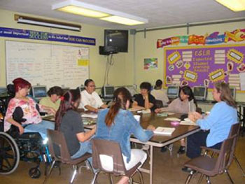


How do we measure our success?
Think about various students in the ABE program.
How would you determine if the program is successful with the student?
How would you measure success?

Slide 32
Measurable Skill Gain Indicator
The Federal Definition: The percentage of participants who, during a program year, are in an education or training program that leads to a recognized postsecondary credential or employment and who are achieving measurable skill gains, defined as academic, technical, occupational, or other forms of progress, towards such a credential or employment.

Slide 33
4 Types of Measurable Skill Gain for ABE
Measurable Skill Gain
Secondary Diploma/ Equivalent
Progress toward Milestones
Secondary or Post-Secondary Transcript
Program Exit + Entry into Postsecondary Education
Educational Functioning Level Gain
Pre-Post Test
Completion of Carnegie Units
Passing Technical / Occupational Knowledge Based Exam
Used in Title II

Slide 34
Counting Measurable Skill Gains (MSG)
Multiple Ways to Count MSG (Only one type of gain will be counted for each participant per period)
1. Earn higher scores on approved pre- and post tests to advance to a higher level
2. Earn a secondary credential (high school or equivalency diploma) by June 30
3. Enter postsecondary education (only after participant exits ABE) by June 30
4. Participants in “adult high school” can complete Adult Basic Education (ABE) Level 5 by earning enough Carnegie Units or credits to move to 11th- or 12th-grade status* (*Not yet applicable for ABE in Minnesota)

Slide 35
Which students will likely show what type of gain?
Measurable Skill Gain
Secondary Diploma/ Equivalent
Progress toward Milestones
Secondary or Post-Secondary Transcript
Program Exit + Entry into Postsecondary Education
Educational Functioning Level Gain
Pre-Post Test
Completion of Carnegie Units
Passing Technical / Occupational Knowledge Based Exam

Slide 36
Interpreting the new Educational Functioning Level Descriptors
Notes:
Heather

Slide 37
The 12 Educational Functioning Levels
ABE | ESL
1 (Beginning ABE Literacy) | 1 (Beginning ESL Literacy)
2 (Beginning Basic Education) | 2 (Low Beginning ESL)
3 (Low Intermediate ABE) | 3 (High Beginning ESL)
4 (High Intermediate ABE) | 4 (Low Intermediate ESL)
5 (Low Adult Secondary) | 5 (High Intermediate ESL)
6 (High Adult Secondary) | 6 (Advanced ESL)

Slide 38
Dive into a Level Together
ABE
1 (Beginning ABE Literacy)
2 (Beginning Basic Education)
3 (Low Intermediate ABE)
4 (High Intermediate ABE)
5 (Low Adult Secondary)
6 (High Adult Secondary)
Form groups of 3-4 people.
As a group, select an ABE level to read and analyze.
Questions as you analyze:
What skills stand out to you at this level?
Can you think of students that meet some or most of this description? Share with the others in your group.
What else is significant about this level from the description?

Slide 39
Compare and Share
ABE
1 (Beginning ABE Literacy)
2 (Beginning Basic Education)
3 (Low Intermediate ABE)
4 (High Intermediate ABE)
5 (Low Adult Secondary)
6 (High Adult Secondary)
Stay in your same small groups.
Now look at the level above or below the one you just analyzed.
Questions as you compare:
What are the differences from level to level?
How would you differentiate between the levels with students in terms of what they might need or how you would work with them?
What else is significant when you compare the level descriptions?

Slide 40
The how and when of the new TABE and CASAS Tests
Notes:
Brad

Slide 41

TABE 11-12 Approved!
The U.S. Department of Education’s Office of Career, Technical and Adult Education (OCTAE) has approved TABE Forms 11 and 12 for the NRS and for local ABE programs in Minnesota.
Computer and paper versions
3 Subject Tests: Reading, Math, Language
5 Level Tests in each subject: L, E, M, D, A
Each test has only 1 option (no survey)
TABE 9 and 10 likely to be dropped from the approved list starting July 1, 2019
Notes:
Brad

Slide 42

TABE 11-12 Test Times
Subject | Revised Maximum Allowable Test Time (levels E, M, D, A)
Math | 75 minutes (2 parts in levels M, D, A timed separately)
Reading | 120 minutes (2 parts timed separately)
Language | 60 minutes

Slide 43
From TABE 9-10 to 11-12
TABE 9 & 10 are not considered the same as 11 & 12 for data purposes, meaning that if a student has a pretest in 9 or 10, the student:
Cannot be post-tested with an 11 or 12.
Does not need to wait 40 contact hours before taking a 11 and 12 as a new pre-test to determine a student’s level.
Notes:
Brad

Slide 44

CASAS New GOALS Reading Test
The U.S. Department of Education approved the new CASAS GOALS Reading test for ABE levels (not ESL) in the NRS.
Not yet approved for local ABE programs in Minnesota but is being submitted by MDE to OCTAE for approval.
Notes:
Brad

Slide 45
New Assessment Policy
See the new Assessment Policy at
www.mnabe.org/abe-law-policy/mn-abe-policies
that includes:
TABE 11 and 12
New Educational Functioning Level Descriptors for ABE levels 1-6
Coming in September: CASAS Goals is being added to the approved list for ABE 1-6 in Reading!
Please note that the revised Educational Functioning Level Descriptors for ESL levels 1-6 are not included since there are no approved tests for the new ESL descriptors yet.

Slide 46
Coming Soon: Supplemental Service Assessment Provider as Central Test Purchaser
Starting later this summer, the Assessment Training ABE Support Network Provider (SouthWest ABE) will coordinate central purchasing of tests (TABE 11 & 12, and eventually CASAS GOALS when approved) with local ABE programs
This allows programs to get the best bulk purchasing rate
Could include paper and/or computer versions of the tests
Local programs will need to pay for the tests
Purchases made potentially annually or semi-annually, upon demand
Email sent by Cherie Eichinger on August 7, 2018, with details on purchasing paper tests. (Computer-based test voucher purchasing information will be distributed this fall.)

Slide 47
Assessment Professional Development
Professional development on tests will be offered at:
Summer Institute
Regionals
Support Services Conference (November 8-9, 2018)
Sessions Offered:
Test Certification (required for all staff working with testing) will provide an overview of the allowable tests
Critical Issues in Assessment will dive into the new tests, computer-based testing and other topics

Slide 48
Discussion: Test Transition Planning with Local ABE Programs
Start thinking now about when you might start transitioning testing:
When will you purchase tests? Which ones will you purchase?
How will you train yourself and your staff on the new tests?
How will your program implement the new tests?
  With current students that already have a pretest?
  With new students?

Slide 49
Getting everything into SiD
(The State ABE Database)
Notes:
Heather

Slide 50
Statewide ABE System Contact Hour Growth From Peak Year
 | 2011-2012 | 2012-2013 | 2013-2014 | 2014-2015 | 2015-2016 | 2016-2017 | 2017-2018
Contact Hours | 5,955,470 | 5,931,207 | 5,607,747 | 5,571,307 | 5,497,385 | 5,302,063 | 4,930,157
Growth from prior year | 2.2% | -0.4% | -5.5% | -0.6% | -1.3% | -3.6% | -7.0%
Note: 2017-18 contact hours were below 5 million. We have not been below 5 million since 2004-2005.

Slide 51
Contact Hour Rates for 2018-19
Contact hour rates for 2018-19 have increased from last year, mainly due to ongoing statewide decline of contact hours. Please check the accuracy of your consortium’s contact hour and funding information in the email from Astrid sent to fiscal agents on July 2, 2018.
Rate | 2017-18 | 2018-19
State | $6.05 | $6.50
Federal | $0.52 | $0.61
Rates rounded to the nearest cent

Slide 52


12 Hour/No Pre-Test Lock
Limit on entering hours for students with No EFL
Started July 1, 2018
Users cannot enter student hours past the 12 hour mark for students who have no EFL.
Users cannot enter student hours past the 30 hour mark for Conditional Work Referral students.

Slide 53
Rolling Lock
3 month rolling lock on student hours and test data entry
Starting March 1, 2018
Data entry and editing of hours and tests that are 3 months old (and older) will be blocked. An error message will appear when old hour and test score data entry or edit is attempted.
If a program finds unentered or incorrect hours/tests, contact SiD Support for assistance.

Slide 54

Examples
On March 1, 2018, users can enter class time and tests for the previous 3 months (Dec, Jan, Feb). As March progresses hours/tests can continue to be entered for Dec, Jan, Feb and March. Time/Test data from before Dec 1 will be blocked from data entry.
On April 1, 2018, users can enter class time and tests for the previous 3 months (Jan, Feb, March). As April progresses hours/tests can continue to be entered for Jan, Feb, March and April. Time/Tests data from before Jan 1 will be blocked from data entry.

Slide 55

Annual ABE Program Data Check Points
All October-April data reviewed by June 1
Programs submit reports via SERVS (Due 6/1)
All May-June data reviewed by July 31
Programs email reports to Cherie (Due 8/1)
All July-September data checked by November 1
No program submission to MDE
MDE pulls and matches data at each due date
Notes:
Todd

Slide 56

TABLE REVIEW AND ANALYSIS
Make sure you are checking the Desk Audit Data Check at least quarterly and before any data deadlines as part of your local monitoring!

Slide 57
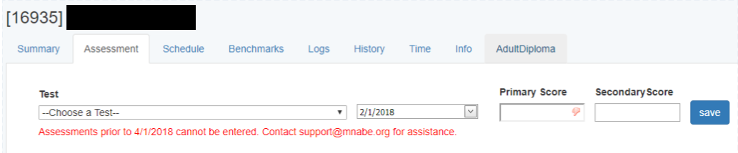
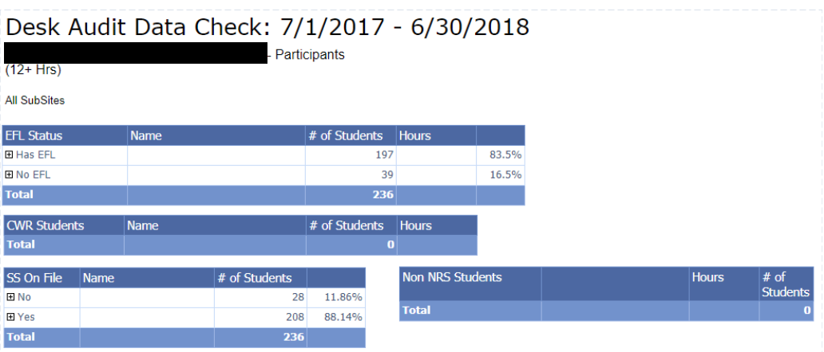

Slide 58
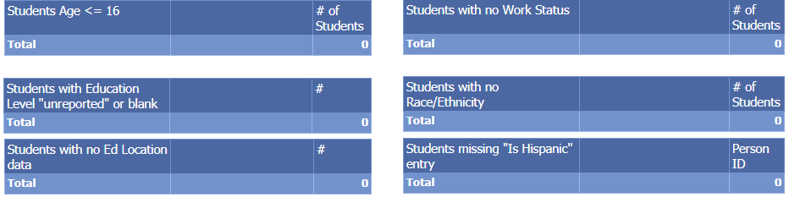
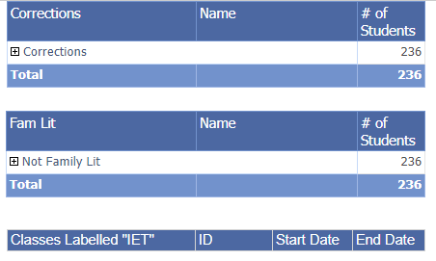

Slide 59
Showing Success
(Targets, Report Cards and Program Improvement)
Notes:
Brad

Slide 60
National Reporting System Negotiated Targets
NRS Educational Functioning Level and Core Indicator Goals | MN FY 2017 (2016-17) |  |  | FY 2019 (2018-19) | FY 2020 (2019-20)
 | % Completing Each Level/Goal |  |  | % Earning Measurable Skill Gain | % Earning Measurable Skill Gain
 | Target | MN Actual | U.S. Actual | Target | Target
ABE 1: ABE Beginning Literacy | 78 | 60 | 48 | 61 | 61
ABE 2: ABE Beginning Basic Education | 67 | 48 | 45 | 48 | 48
ABE 3: ABE Intermediate Low | 50 | 41 | 42 | 43 | 43
ABE 4: ABE Intermediate High | 34 | 37 | 42 | 40 | 41
ABE 5: Low Adult Secondary | 26 | 29 | 52 | 46 | 52
ABE 6: High Adult Secondary | N/A** | 28 | 42 | 36** | 42**
ESL 1: ESL Beginning Literacy | 48 | 45 | 44 | 45 | 45
ESL 2: ESL Beginning Low | 58 | 56 | 50 | 56 | 56
ESL 3: ESL Beginning High | 51 | 46 | 50 | 47 | 51
ESL 4: ESL Intermediate Low | 39 | 39 | 45 | 42 | 45
ESL 5: ESL Intermediate High | 35 | 35 | 39 | 37 | 37
ESL 6: ESL Advanced | 16 | 23 | 24 | 25 | 26

Slide 61

Program Improvement

Slide 62
Program Improvement Restart
Q: When will the next Program Improvement process take place?
A: Results from program year 18-19 will be used for a Program Improvement process starting Fall 2019.
Program Improvement Q&A

Slide 63
Program Improvement Overview
Q: What is Program Improvement?
A: A technical assistance process for ABE programs identified as low-performing on key accountability measures.
Q: Why Program Improvement?
A: To promote quality ABE programming; to work towards consistent implementation of accountability practices statewide; to ensure compliance with federal accountability standards.
Program Improvement Q&A

Slide 64
Program Improvement Previous Process
Q: What accountability measure was Program Improvement based on in the past?
A: Level gains.
Q: What was the Program Improvement process in the past?
A: It had four parts -
  Fall workshop
  Reports on changes and improvement due in February
  Site visit
  Technical assistance throughout
Program Improvement Q&A

Slide 65
Program Improvement Looking Ahead
Q: What will Program Improvement look like in the future?
A: Good question.
What we know:
The intention in the future is to connect Program Improvement with Program Quality Standards
For program year 18-19, level gains will still be a main focus/indicator
The process will probably still involve a fall workshop, a site visit and improvement planning with technical assistance
More information at the Fall ABE Managers Workshop on September 25
Program Improvement Q&A

Slide 66
Resources
Notes:
Heather

Slide 67
Helpful Links For More Information
Minnesota Adult Basic Education (ABE) main website: www.mnabe.org
SiD support articles and information: https://mnabe.zendesk.com
SiD Login: www.sid.mnabe.org
Minnesota ABE Assessment: www.mnabeassessment.com
Minnesota Department of Education (MDE): https://education.mn.gov/MDE/index.html
National Reporting System (NRS): https://www.nrsweb.org
GED Testing Service: https://ged.com
TABE: http://tabetest.com
CASAS: https://www.casas.org
BEST PLUS: http://www.cal.org/aea/bp/
See your handout for additional resources.

Slide 68
Local Changes, Ideas and Questions
Notes:
Heather

Slide 69
Discuss in Small Groups
How does the information from today impact your work?
What is one important piece of information from today’s session that you will take back to your program?
What ideas for changes or improvements might you be considering for your program, based on today’s session?
What additional questions do you have?

Slide 70
Thank you!
Todd Wagner, State ABE Director, Minnesota Department of Education
Todd.Wagner@state.mn.us
651-582-8466
Jenny Schlukebier, SiD/Urban Planet
support@mnabe.org
Heather Williams, SPARC Chair & Robbinsdale ABE Program Support Professional
Heather_williams@rdale.org
Brad Hasskamp, Adult Secondary Credential & Education Policy Specialist, Minnesota Department of Education
Brad.Hasskamp@state.mn.us
651-582-8594

